Slide 1
Internet Censorship and Online Speech Chapter 2: Protocol Censorship
Nick Feamster University of Chicago

Slide 2
Forms of Internet Protocol Interference
Internet Protocol (IP) Blocking
Transmission Control Protocol (TCP) Blocking
Domain Name System (DNS) Blocking and Manipulation
Web (HTTP) Block Pages / Redirection
Border Gateway Protocol (BGP) Hijacking

Slide 3
Lecture Outline
Brief Internet Protocol Background
TCP/IP
BGP
DNS
TCP/IP Filtering/Blocking
BGP Hijacking
DNS Manipulation and Redirection

Slide 4
IPv4 Addresses
Topological Addressing
32-bit number in “dotted-quad” notation
www.cs.uchicago.edu --- 128.135.164.125
128
135
164
125
10000000
10000111
10001100
01111101
Network (16 bits)
Host (16 bits)
Problem: 2³² addresses is a lot of table entries
Solution: Routing based on network and host
130.135.0.0/16 is a 16-bit prefix with 2¹⁶ IP addresses

Slide 5
IPv6: Motivation
initial motivation: 32-bit address space soon to be completely allocated.
additional motivation:
header format helps speed processing/forwarding
header changes to facilitate QoS
IPv6 datagram format:
fixed-length 40 byte header
no fragmentation allowed

Slide 6
IPv6: More Addresses
priority: identify priority among datagrams in flow
flow Label: identify datagrams in same “flow.”
(concept of“flow” not well defined).
next header: identify upper layer protocol for data
ver
pri
flow label
payload len
next hdr
hop limit
source address
(128 bits)
destination address
(128 bits)
data
32 bits

Slide 7
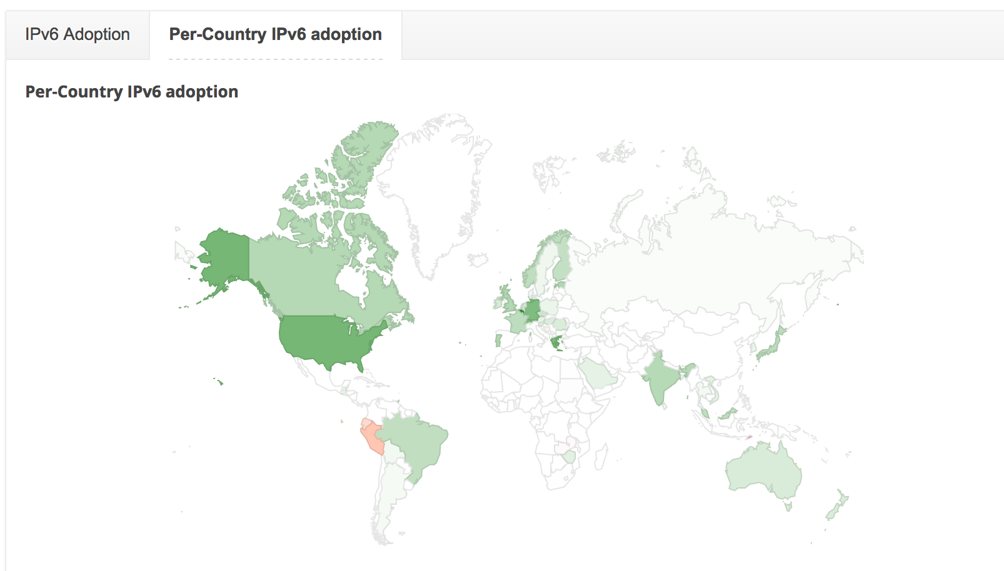
Per-Country IPv6 Adoption

Slide 8
Internet Routing Protocol: BGP
Autonomous Systems (ASes)
Route Advertisement
Destination Next-hop AS Path
128.135.0.0/16
Traffic
192.5.89.89
10578..160
128.135.0.0/16
66.250.252.44
174… 160
Session
Notes:
Diagram of routing table is very confusing because it’s not pointing to anything
Green arrow shorter, and too thick… green is a msg
More intuition about how the system actually works.
Don’t say “interdomain”
DESTINATION-BASED Routing
Tables look like a set of possible routes and a rankings over these routes
(pop up a simplified table fragment)

Slide 9
Checking IP Address Ownership: Whois
NetRange: 128.135.0.0 - 128.135.255.255
CIDR: 128.135.0.0/16
NetName: U-CHICAGO
NetHandle: NET-128-135-0-0-1
Parent: NET128 (NET-128-0-0-0-0)
NetType: Direct Assignment
OriginAS: AS160
Organization: University of Chicago (UNIVER-174)
RegDate: 1986-07-07
Updated: 2012-01-17
Ref: https://rdap.arin.net/registry/ip/128.135.0.0
OrgName: University of Chicago
OrgId: UNIVER-174
Address: 1155 E. 60th Street
City: Chicago
StateProv: IL
PostalCode: 60637
Country: US
RegDate: 1986-07-07
Updated: 2017-01-28
Ref: https://rdap.arin.net/registry/entity/UNIVER-174
Database may be out of date, but is a good approximation of ownership.

Slide 10
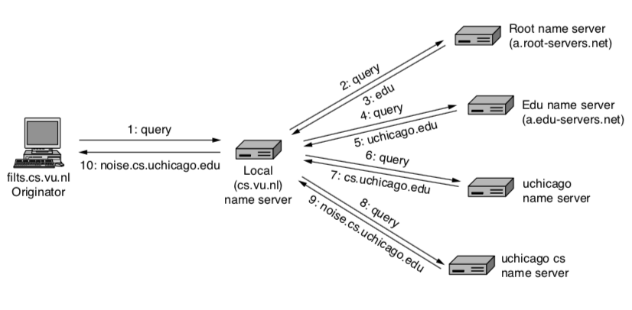
DNS: Mapping Names to Addresses

Slide 11
Using DNS
Local DNS server (“default name server”)
Usually near the end hosts who use it
Local hosts configured with local server (e.g., /etc/resolv.conf) or learn the server via DHCP
Client application
Extract server name (e.g., from the URL)
Do gethostbyname() or getaddrinfo() to get address
Server application
Extract client IP address from socket
Optional gethostbyaddr() to translate into name
11

Slide 12
Manipulation and Interference

Slide 13
Protocol Interference: TCP/IP Firewalls
Need a topological “chokepoint”
If the network is a graph, the firewall is a cut in the graph that partitions the graph into two or more disjoint components
Often used to protect devices where there is an easy way to separate “good” from “bad” devices.
Common firewall software
Snort
Iptables
Commercial Software: Blue Coat

Slide 14
Detection of Censored Content
IP-based: Filter based on destination IP address
Note: May be challenging in some circumstances, such as cloud-hosted services
DNS-based: Filter based on domain name
Note: May become more complicated as DNS traffic becomes encrypted
Deep Packet Inspection (DPI)-based: Perform more sophisticated attempts to filter based on contents of packet
Web fingerprinting
…

Slide 15
TCP RST Injection
On-path firewall system can detect content that should be censored and inject traffic that resets the TCP connection.
Causes client to abort the connection or report some kind of generic error.

Slide 16
TCP Packet Injection
If an end-host receives two packets with the same sequence number, the operating system will discard the second packet.
Traffic can thus be suppressed by injecting a packet “ahead” of the valid response.

Slide 17
Border Gateway Protocol
Internet’s interdomain routing protocol, BGP, essentially has no security — will believe any routes advertised by neighboring router.
Different ways to interfere with Internet routing:
Cut-off (Egypt case)
BGP “route hijacking”

Slide 18
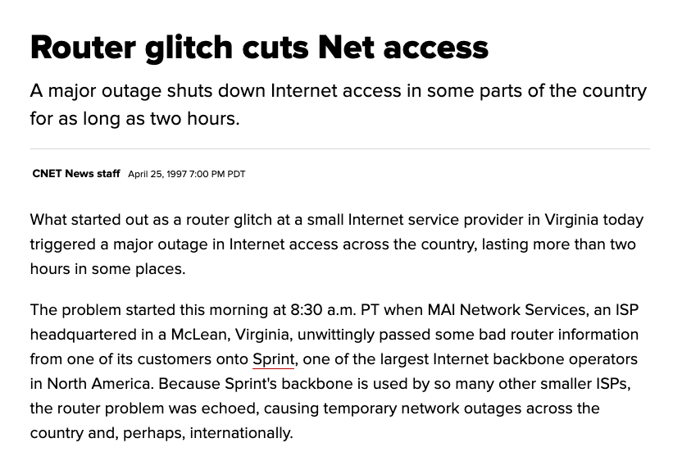

Slide 19
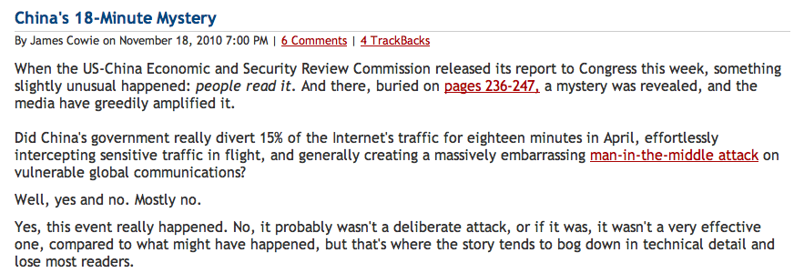
China’s Accidental Hijack

Slide 20
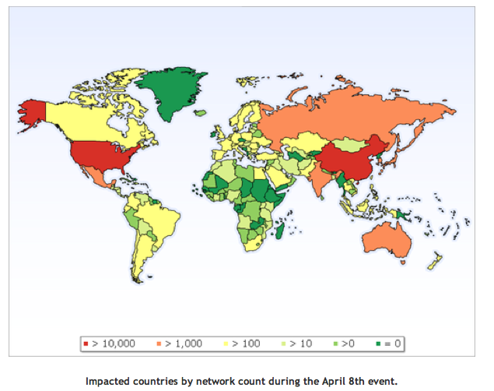
China Hijack: Sequence of Events
On April 8, 2010, China advertised about 50,000 blocks of IP addresses from 170 different countries
60,000 prefixes from the US
Event lasted for 20 minutes
Why did most people not notice?
How might more traffic have been intercepted?
http://www.renesys.com/blog/2010/11/chinas-18-minute-mystery.shtml

Slide 21
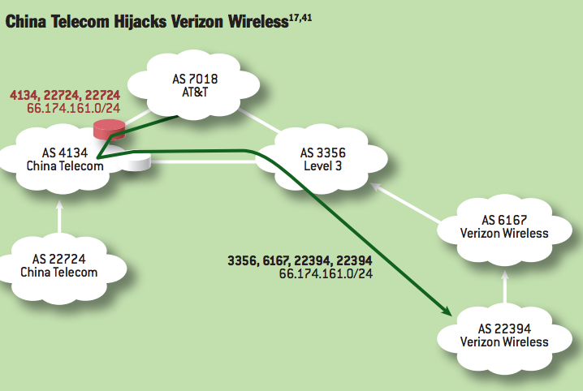
Notes:
China Telecom’s AS 22724 hijacks Verizon Wireless’s prefix 66.174.161.0/24. The bogus route originated by AS 22724 propagates through the AS-level graph and is eventually selected by AT&T because it is shorter than the legitimate route originating at Verizon Wireless’s AS 22394. Meanwhile, Level3 selects the legitimate route, because it is shorter than the bogus route. Thus, network traffic splits between the hijacking AS and the legitimate origin AS, with the nature of the split depending on routing policies used by individual ASes and the topology of the AS-level graph.

Slide 22
Other “Famous” Hijack Events
February 24, 2008: Pakistan advertises a small part of YouTube’s AS 36561
Likely as a botched attempt to block YouTube in Pakistan, following a government order
January 22, 2006: Con Edison (AS 27605) mistakenly advertises lot of networks (Level 3, UUNet, Panix ISP, …)
April 25, 1995: AS 7007 incident
“Ultimately, though, the problem remains on of transitive trust. A provider can and should limit the advertisements it will accept from a customer.”

Slide 23
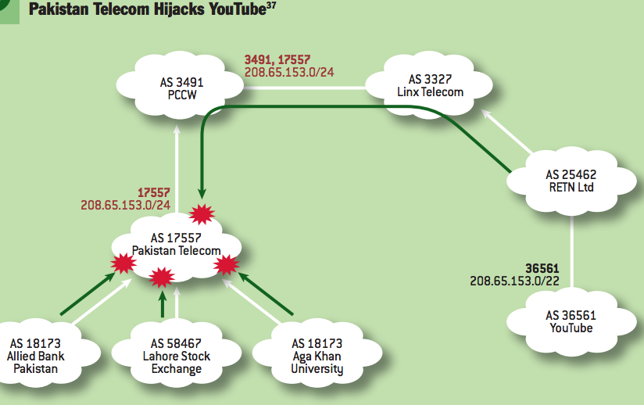
Notes:
Perhaps the most famous subprefix hijack occurred on February 24, 2008, when Pakistan Telecom took YouTube offline. The incident2 began when Pakistani authorities demanded that YouTube to be censored within Pakistan. To accomplish this, Pakistan Telecom’s AS 17557 launched a subprefix hijack by originating the subprefix 208.65.153.0/24 of YouTube’s prefix 208.65.153.0/22 to its customer ASes in Pakistan (e.g., Aga Khan University, Lahore Stock Exchange, Allied Bank Pakistan), as in figure 3.37,41 This meant that traffic destined for YouTube’s servers in AS 36561 would instead be forwarded to the longer IP prefix originated by Pakistan Telecom’s AS 17557, where traffic could then be dropped. Events took an unexpected turn when Pakistan Telecom’s bogus BGP announcement leaked out of Pakistan. PCCW, a large ISP that provides global network connectively to Pakistan Telecom, received the bogus routing announcement, selected the bogus route, and announced it to its own neighbors. Because the bogus route was for a longer prefix (/24) than the legitimate route (/22), longest-prefixmatch routing meant the bogus route was always more preferred by the legitimate route, and within minutes, at least two-thirds of the Internet was sending its YouTube traffic to Pakistan.2

Slide 24
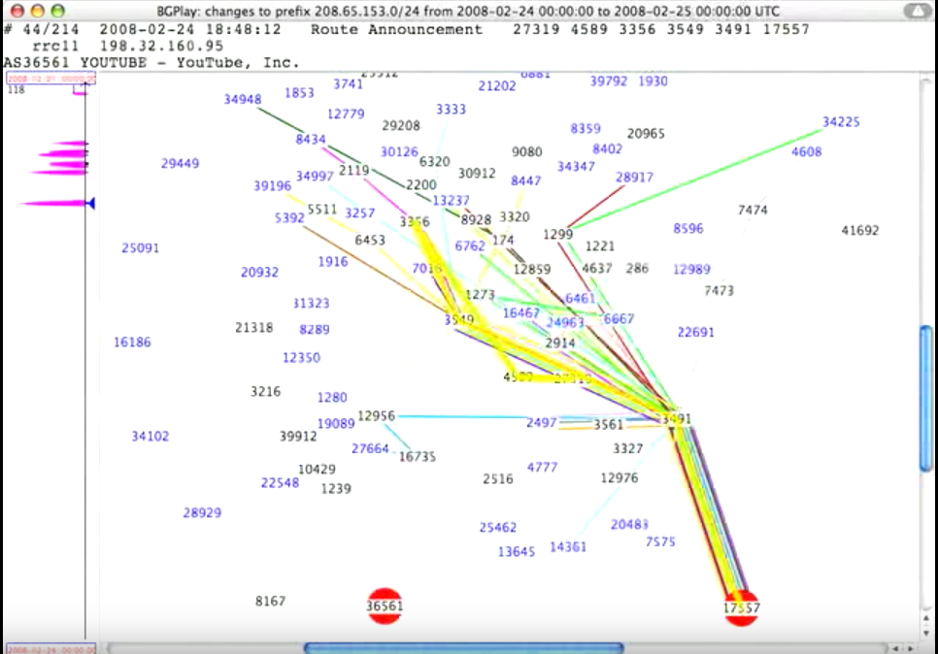
Notes:
https://www.youtube.com/watch?v=IzLPKuAOe50

Slide 25
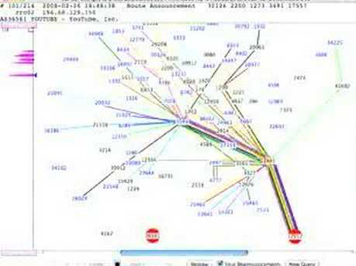

Slide 26
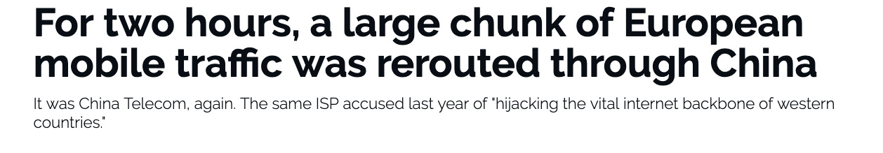
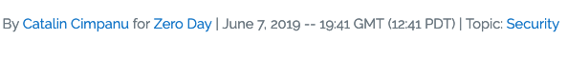
BGP Hijacking Continues…
Notes:
https://www.zdnet.com/article/for-two-hours-a-large-chunk-of-european-mobile-traffic-was-rerouted-through-china/

Slide 27
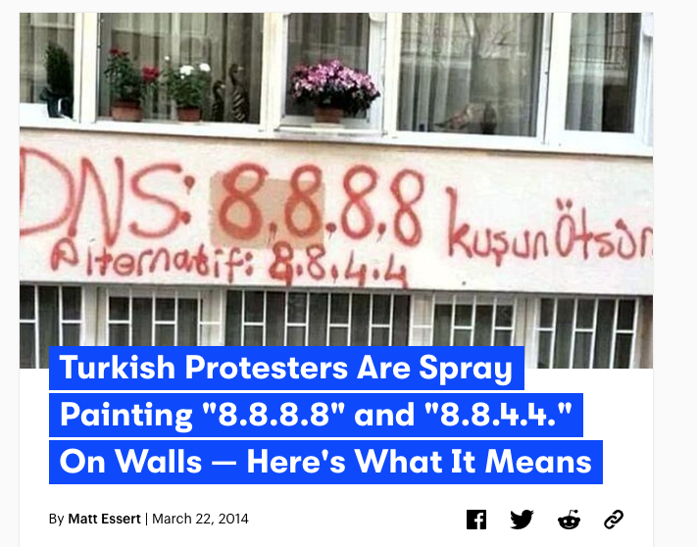
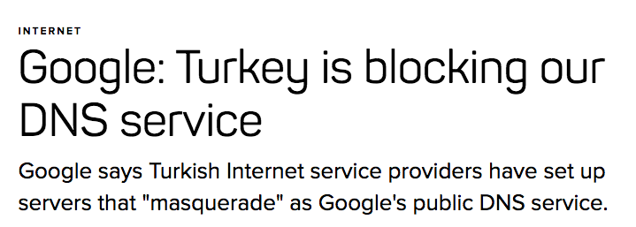

Slide 28
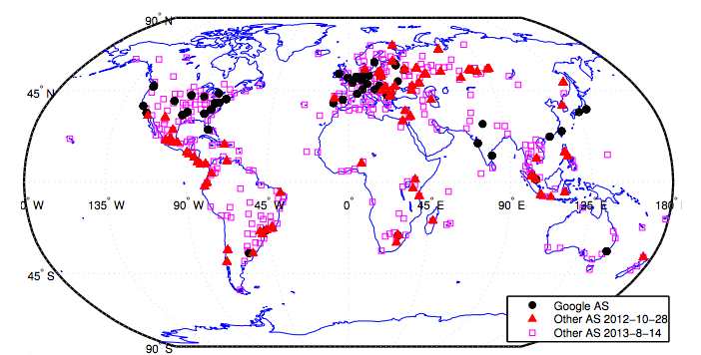
Detecting DNS Manipulation
Strawman: Find instances where the IP address returned does not agree with the “right answer”.
Problem: There is not a single right answer…
Extreme example: IP addresses returned for google.com (Katz-Bassett et al.)
Pearce, Paul, et al. "Global Measurement of DNS Manipulation." 26th {USENIX} Security Symposium ({USENIX} Security 17). USENIX} Association, 2017.

Slide 29
Consistency Metrics
IP Address
Autonomous System (“ISP”)
HTTP Content returned
Consistency of HTTPS certificate
Reverse DNS lookup (IP address to name)

Slide 30
Independently Verifiable Metrics
Content of HTTPS Certificate
Does the IP address present a correct domain in a valid, browser-trusted certificate
Same test, but with certificate fetched with SNI (the domain name)

Slide 31
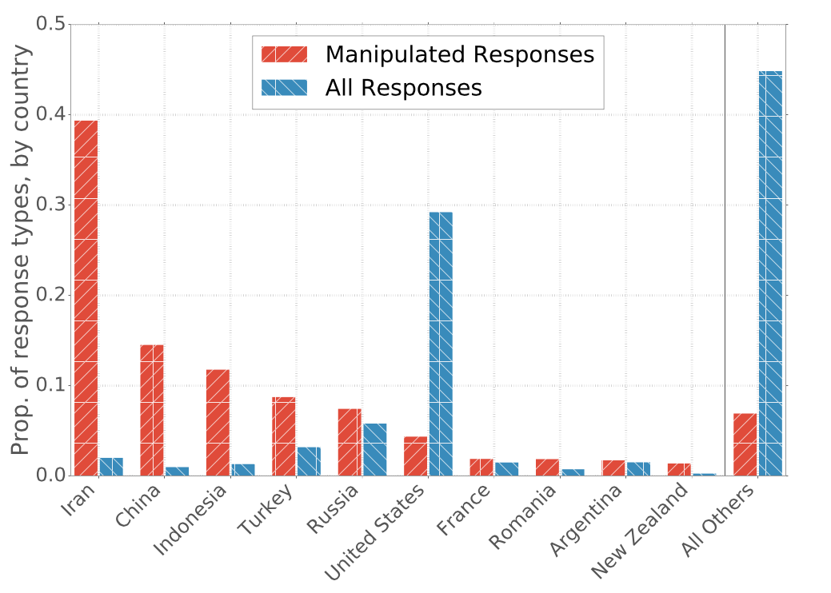
Prevalence of Manipulation by Country

Slide 32
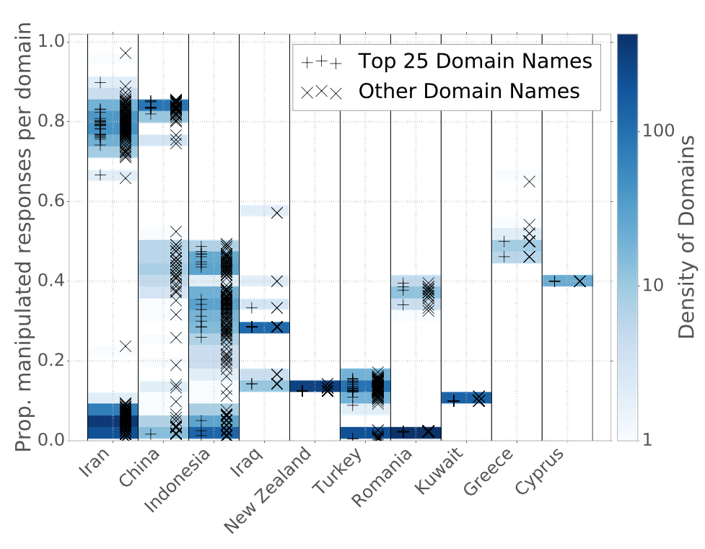
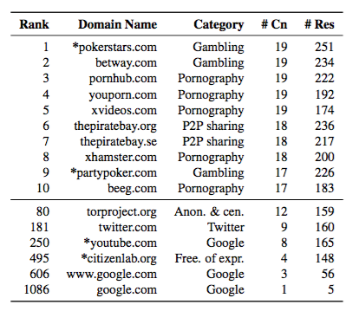
Manipulation of Domains within Countries
Notes:
----- Meeting Notes (4/14/17 13:50) -----
Need a version of this plot by category.

Slide 33
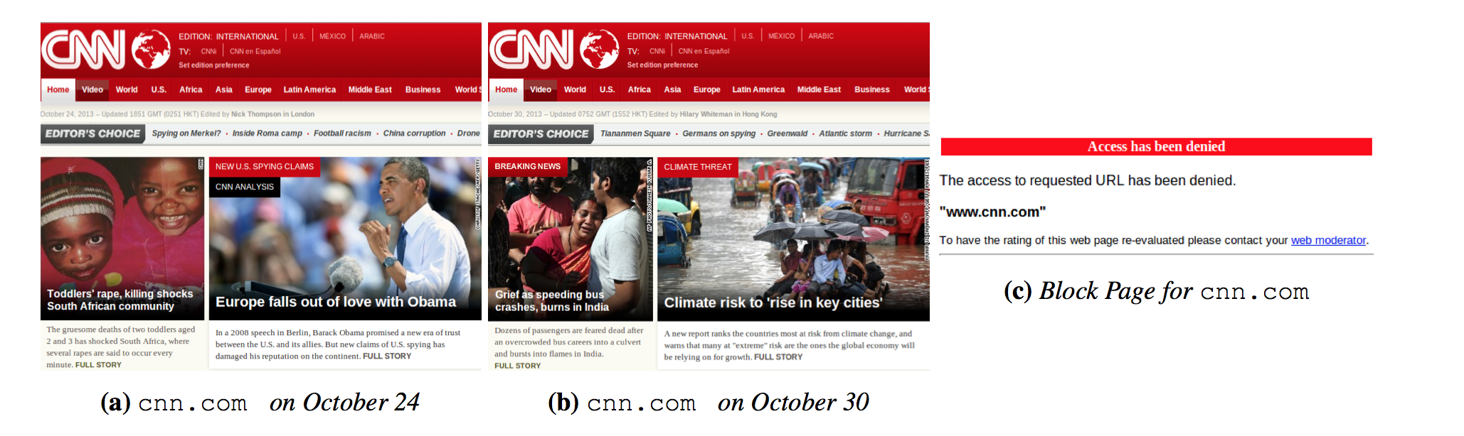
HTTP/Web Filtering: Block Pages
Differences in accessible pages inhibit block page detection
Pages are structurally similar, but contain different content
Lots of possible metrics, but length works well!
Jones et al., “Automated Detection and Fingerprinting of Censorship Block Pages”. ACM Internet Measurement Conference. 2014.

Slide 34
Protecting Against DNS Manipulation
DNSSEC protects against data spoofing and corruption
DNSSEC also provides mechanisms to authenticate servers and requests
DNSSEC provides mechanisms to establish authenticity and integrity

Slide 35
DNSSEC: New RRs
TWO Public Key-related RRs
RRSIG: signature over RRset made using private key
DNSKEY/DS: public key, needed for verifying a SIG over a RRset, signed by the parent’s private key
One RR for internal consistency (authenticated denial of data)
NXT RR to indicate which RRset is the next one in the zone
Notes:
RFC 2535 discusses these RRs in detail.
CERT RR is outside the scope of this course.

Slide 36
RRSIG
Cover each resource record set with a public-key signature which is stored as a resource record called SIG RR
SIG RRs are computed for every RRset in a zone file and stored
Add the corresponding pre-calculated signature for each RRset in answers to queries
Must include the entire RRset in an answer, otherwise the resolver could not verify the signature

Slide 37
DNSSEC: Verifying the Tree
Question: uchicago.edu
. (root)
uchicago.edu A?
resolver
ask .edu server
SIG (the IP address and PK of .edu server)
by its private key
stub
resolver
uchicago.edu A ?
xxx.xxx.xxx.xxx
.edu
transaction
signatures
add to cache
ask uchicago.edu server
SIG(the IP address and PK of princeton.edu server)
by its private key
SIG(xxx.xxx.xxx.xxx)
by its private key
uchicago.edu
uchicago.edu
Notes:
RRSIG - Contains a cryptographic signature
DNSKEY - Contains a public signing key
DS - Contains the hash of a DNSKEY record
NSEC and NSEC3 - For explicit denial-of-existence of a DNS record
In DNSSEC, each zone has a public/private key pair. The zone's public key is published using DNS, while the zone's private key is kept safe and ideally stored offline. A zone's private key signs individual DNS data in that zone, creating digital signatures that are also published with DNS.
When an end user wants to access a website, a stub resolver on the user's computer requests the website's IP address from a recursive name server. After the server requests this record, it also requests the DNSSEC key associated with the zone. This key allows the server to verify that the IP address record it receives is identical to the record on the authoritative name server.
If the recursive name server determines that the address record has been sent by the authoritative name server and has not been altered in transit, it resolves the domain name and the user can access the site. This process is called validation. If the address record has been modified or is not from the stated source, the recursive name server does not allow the user to reach the fraudulent address. DNSSEC can also prove that a domain name does not exist. As a result of this process, DNS queries and responses are protected from man-in-the-middle (MITM) attacks and the kind of forgeries that could possibly redirect Internet users to phishing and pharming sites.

Slide 38
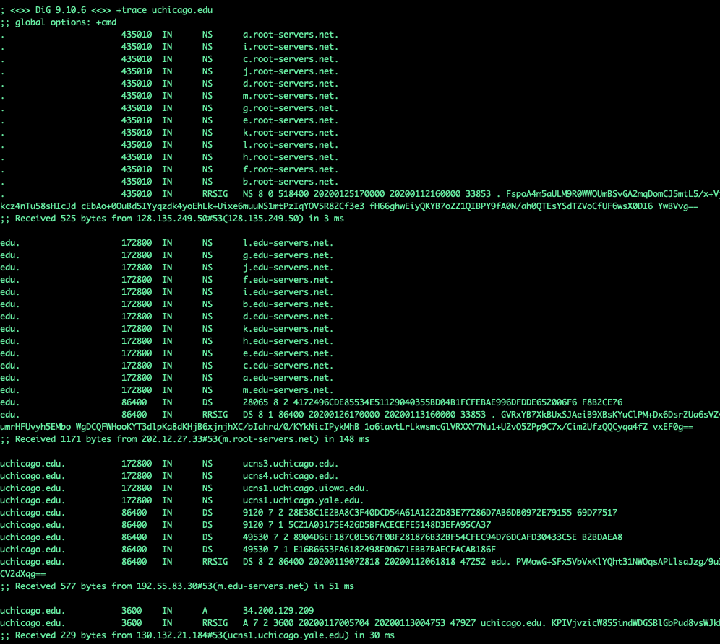

Slide 39
Related Issue: DNS Privacy

Slide 40
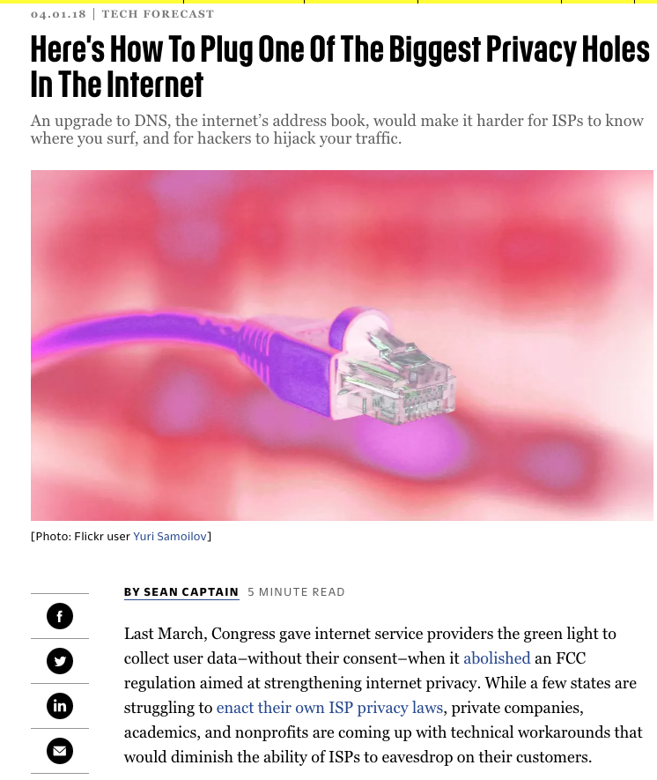

Slide 41
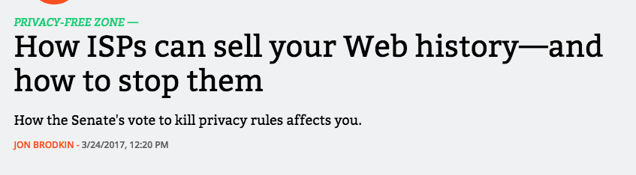
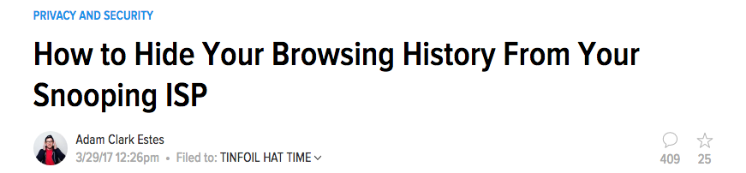
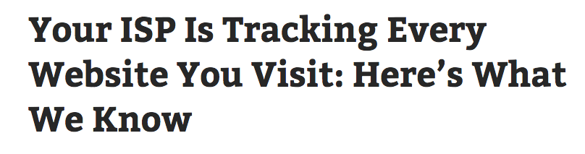
A Discussed Concern...

Slide 42


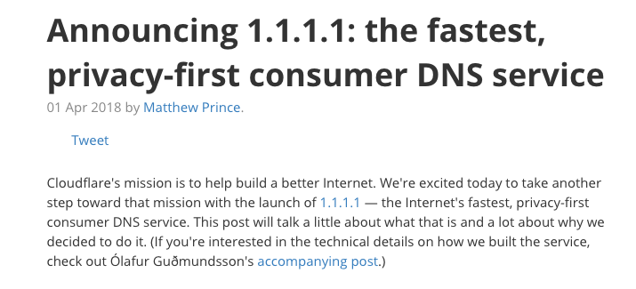
Strawman: Change DNS Providers

Slide 43
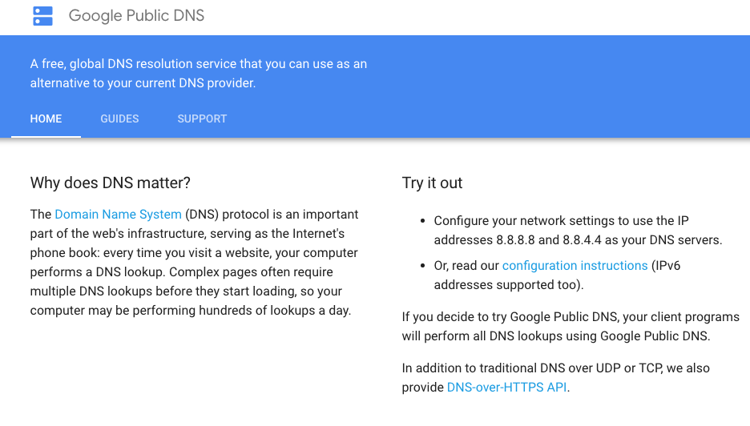

Slide 44
Problem Solved?
No. Just shifted the point of trust from your ISP/default DNS operator to some other party
IP address and DNS domain name still visible and coupled (even with T-DNS, DNSSEC, etc.)
All of the original threats (privacy, censorship, etc.) still remain
Incentives may be different but the technical flaws remain

Slide 45
Oblivious DNS
Key insight: Decouple the DNS query (and response) from the IP address that issued the query
Obfuscate the DNS query before sending it to the local recursive resolver
Generate a referral to an ODNS authoritative server that can decipher the query
ODNS authoritative can see the query, but not the IP address that issued the query*

Slide 46
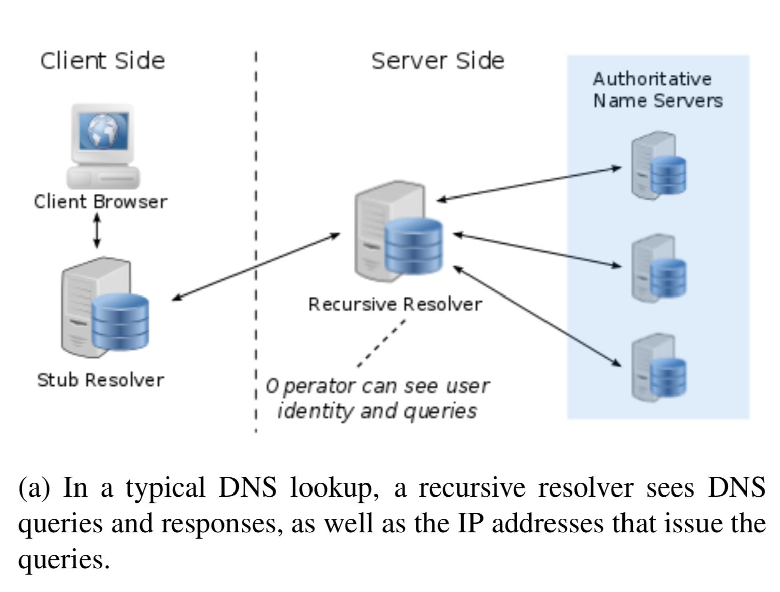
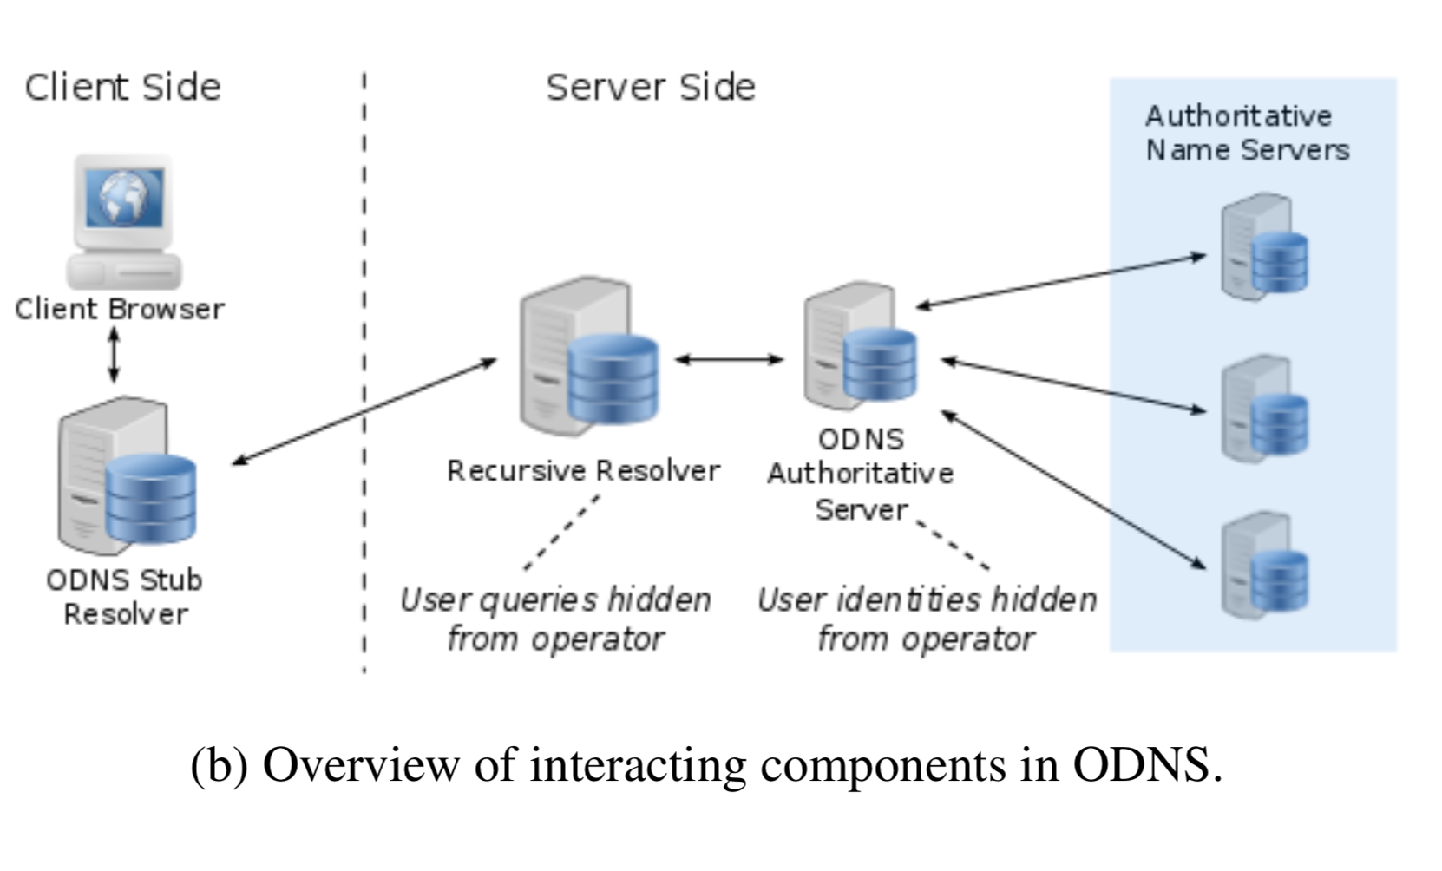
Conventional DNS
Oblivious DNS (ODNS)

Slide 47
Rate Limiting and Throttling

Slide 48
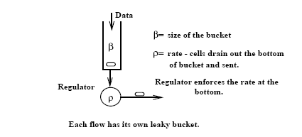
Leaky Bucket Traffic Shaper
Developed by Jon Turner, 1986 (Washington University, St. Louis)

Slide 49
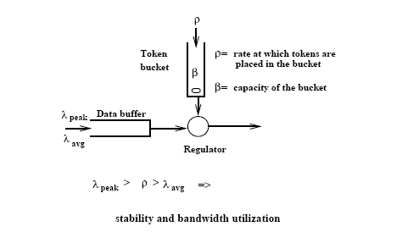
Token Bucket Traffic Shaper

Slide 50
Comparison between TB and LB
Token Bucket | Simple Leaky Bucket
TB permits burstiness, but bounds it | LB forces bursty traffic to smooth out
Burstiness is bounded as follows: - Flow never sends more than β+τ*ρ tokens worth of data in interval τ and - Long-term transmission rate will not exceed ρ | Flow never sends faster than ρ worth of packets per second
TB does not have discard or priority policy | LB has priority policy
TB more flexible | LB is rigid
TB is easy to implement Each flow needs counter to count tokens, each flow needs timer to determine when to add new tokens to the counter | LB is easy to implement

Slide 51
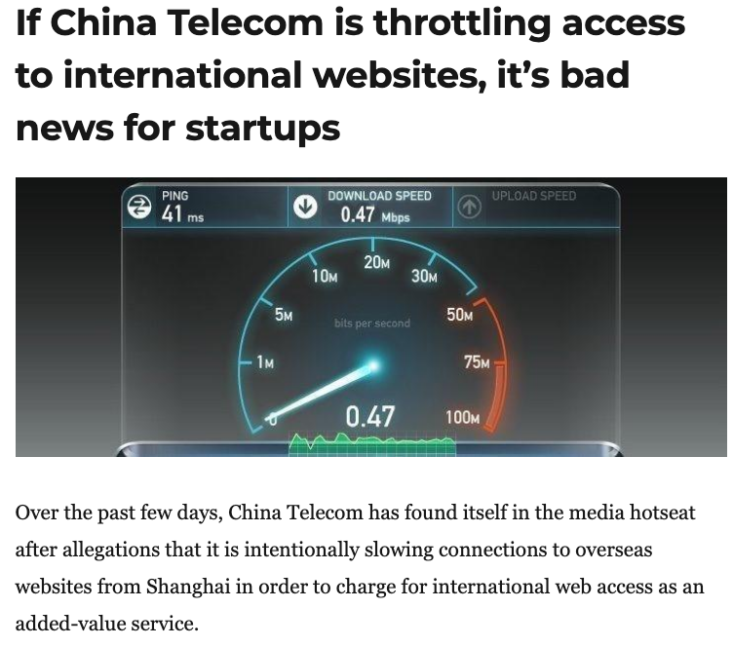
Throttling and Rate Limiting
An example of what Roberts calls “friction”: Increase the cost of accessing a site or service by slowing it down.
Very hard to detect reliably!

Slide 52
Summary: Protocol Censorship
Protocol manipulation: Interferes with communication
TCP/IP: Blocking, packet injection
DNS: Manipulation, redirection, …
BGP: Blocking, hijacking
Throttling/rate limiting: Increases friction for accessing sites and services
Open problems: Detecting different types of manipulation

